Slide 1
Create a new stylesheet called Hotel Style
Style Sheet
H1 | Arial Font, Centre, Bold & 22PX
H2 | Browsers Default Sans- Serif Font, Italic Left & 16PX
H3 | Browsers Default Serif Font, Centre & 18PX
H4 | Helvetica, but if not available then Arial, or if these fonts are not available, then browser’s default sans-serif font, Bold & 16PX
P | Times New Roman Font, Fully Justified & 12PX
LI | Arial, 14PX
OL | Decimal, Italic
UL | Square
Table | Padding: Top 5 PX & Bottom 5PX
 | Margin: Right & Left Auto (Centre Aligned)
 | Internal gridline width 1 PX
 | External gridline width 3 PX
 | All Collapsed
 | All Solid Line

Slide 2
2. Apply Color Attributes
Style Sheet |  | Colour Components
Style | Attribute | Red | Green | Blue
Body |  | Yellow
H1 |  | Full Red | No Green | No Blue
H2 |  | Black
H3 |  | No Red | No Green | Full Blue
H4 |  | Black
P |  | Black
OL |  | No Red | NO Green | Dark Blue
UL |  | 50% Red | No Green | No Blue
Table | External Border | No Red | No Green | Full Blue
 | Internal border | No Red | Dark Green | No Blue
 | Background | Light Grey
 | Red | Green | Blue | RGB
# | FF | FF | FF | White
# | FF | 00 | 00 | Full Red
# | 00 | FF | 00 | Full Green
# | 00 | 00 | FF | Full Blue
# | C0 | 00 | 00 | ¾ ON (75%) Red
# | 80 | 00 | 00 | ½ On (50%) Red
# | 40 | 00 | 00 | ¼ on (25%) (Darker Shade)
# | 00 | 00 | 00 | OFF (Black)

Slide 3
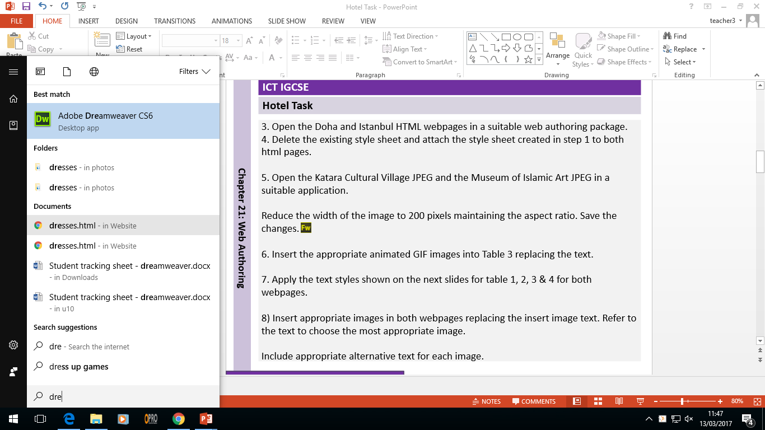

3. Open the Doha and Istanbul HTML webpages in a suitable web authoring package. 4. Delete the existing style sheet and attach the style sheet created in step 1 to both html pages. 5. Open the Katara Cultural Village JPEG and the Museum of Islamic Art JPEG in a suitable application. Reduce the width of the image to 200 pixels maintaining the aspect ratio. Save the changes. 6. Insert the appropriate animated GIF images into Table 3 replacing the text. 7. Apply the text styles shown on the next slides for table 1, 2, 3 & 4 for both webpages. 8) Insert appropriate images in both webpages replacing the insert image text. Refer to the text to choose the most appropriate image. Include appropriate alternative text for each image.

Slide 4
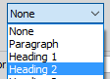

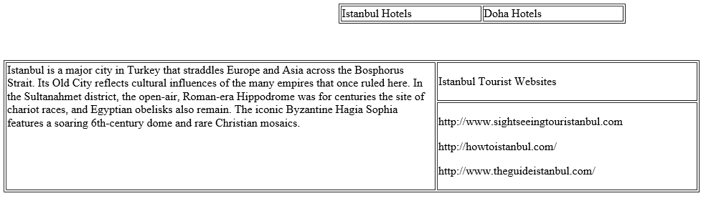
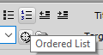

Table 1
H1 Style
H2 Style
Paragraph Style
OL List
Table 3

Slide 5

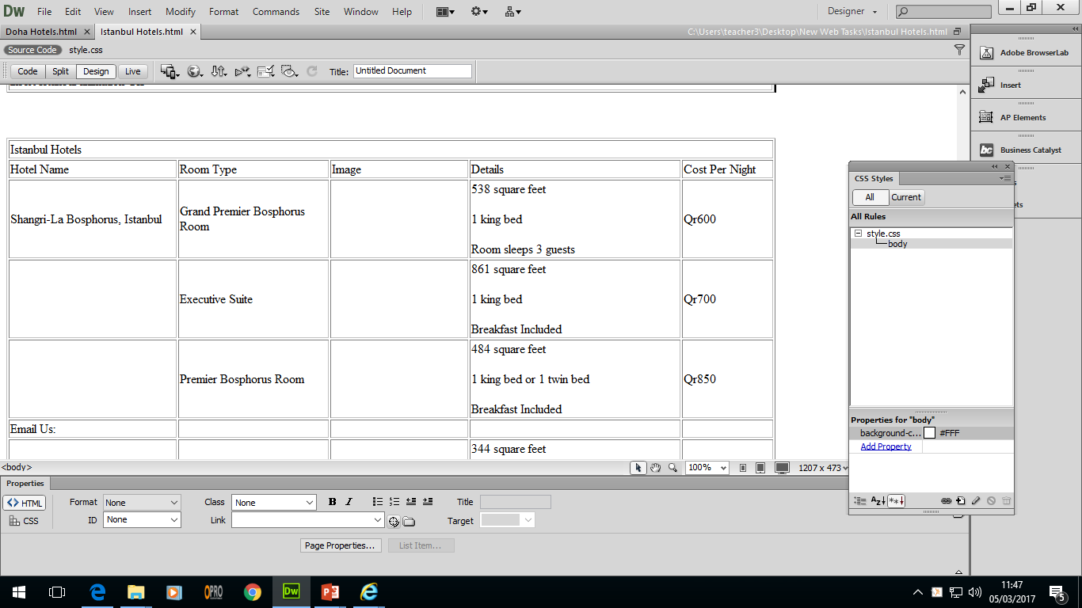

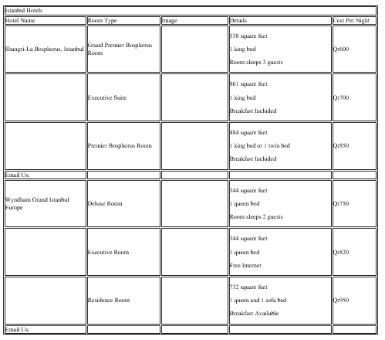

Table 4
H1 Style
H3 Style
UL Style
H4 Style
Paragraph Style for all remaining text

Slide 6
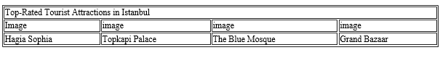
Table 5
H1 Style
H2 Style

Slide 7
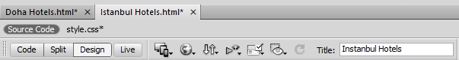
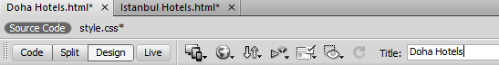
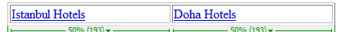
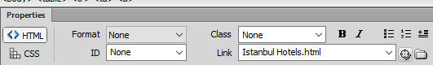

9. Set suitable titles for each web page. 10. Create internal Hyperlinks between the two pages (Repeat steps for both pages).
Preview links in the browser.

Slide 8
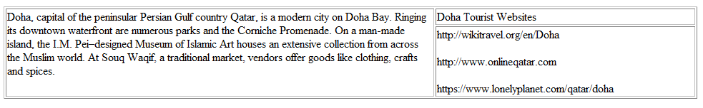
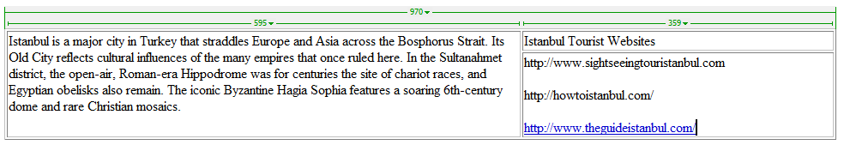
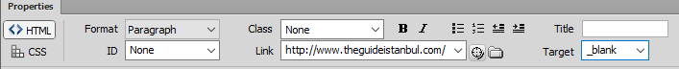
11. Create external links to open on a new window for both webpages.

Slide 9
12. Find and merge the row which contains email us. Create email links to Bookings@gmail.com with a subject line: Summer Hotel Booking 13) Make the text Click here a hyperlink to return to the top of the page. 14) Make the text Click here to return to Istanbul/Doha Hotels a hyperlink to return to the hotel table. 15) Create a test table to carry out suitable tests on your website. You can also test the following: External links, Email Links, Named anchors, images appearing, correct text styles applied.
Email Link with a subject Line
mailto:Bookings@gmail.com ?subject=Summer Hotel Booking
Test | How | Expected | Actual | Action Taken
Checking internal Hyperlinks | Click on each link in the browser | All links to go to the correct page. | All links work as expected. | No action required.

